Slide 1




MY SQL PROJECT
STUDENTS DATABASE MANAGEMENT SYSTEM
- Nidhi Sawant

Slide 2



Students Database Management System
I chose the Students Database Management System because it’s essential for organizing student and faculty information in schools and colleges. Building this project allowed me to understand how databases work and how they can simplify data management in an educational setting.
Importance of a Students Database Management System
Centralized Storage: All student and faculty data is stored in one place, making it easy to find and update information.
Efficiency: Automates tasks like managing courses and grades, saving time and reducing errors.
Data Analysis: Helps in tracking student performance and course enrollments, supporting better decision-making.
Security: Keeps sensitive information safe and protected.
Scalability: Can handle more students and courses as the institution grows.
This system is valuable for educational institutions, making data management easier and more effective.

Slide 3

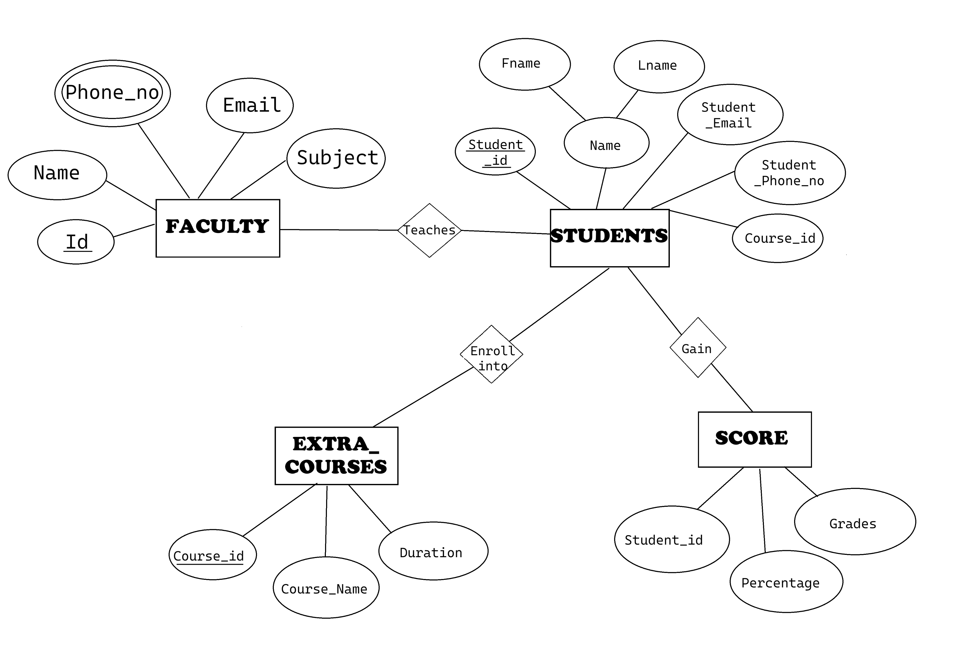
ER DIAGRAM

Slide 4



DESCRIPTION OF ER DIAGRAM
Entities:
Faculty (Id, Name, Phone_no, Email, Subject)
Students (Student_Id, Fname, Lname, Student_Phone_no, Student_Email, Course_id)
Extra_Courses (Course_Id, Course_Name, Duration)
Score (Student_id, Percentage, Grades)
Relationships:
Faculty teaches Students
Students enrol into Extra Courses
Scores are gained by Students

Slide 5

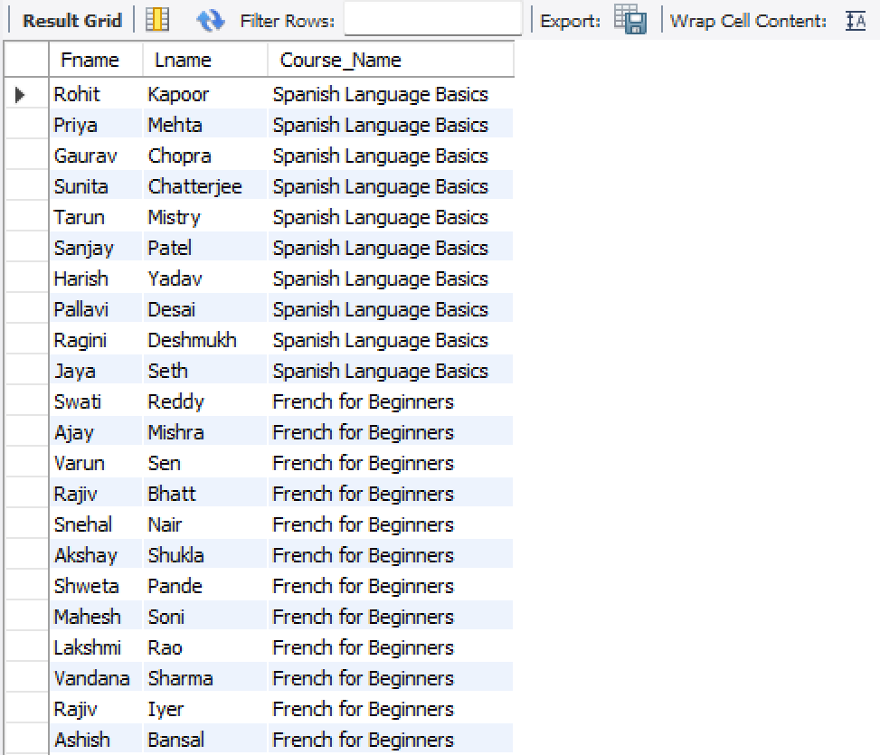

Q1. Display each student’s first name, last name, and course name
SELECT S.Fname, S.Lname, C.Course_Name
FROM Students as S
JOIN Extra_Courses C ON S.course_id = C.Course_id;

Slide 6


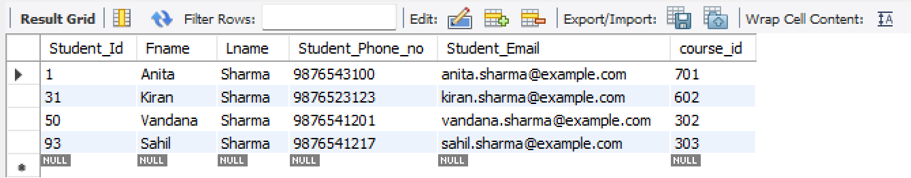
SELECT * FROM Students WHERE Lname = 'Sharma';
Q2. Select all student records where the last name is Sharma

Slide 7

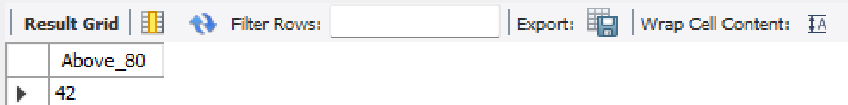
SELECT COUNT(Student_id) AS Above_80 FROM Score WHERE Percentage > 80;
Q3. Get the total number of students who scored above 80 Percentage

Slide 8

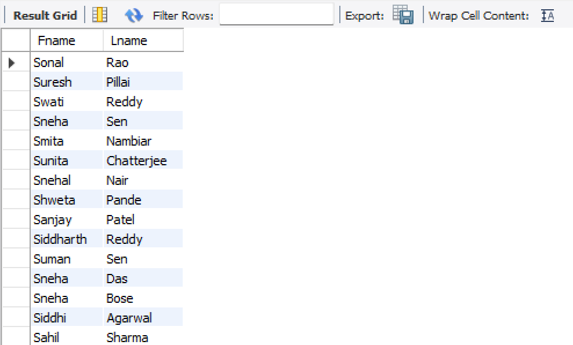

SELECT Fname, Lname
FROM Students
WHERE Fname LIKE 'S%';
Q4. List students whose first names start with the letter ‘S’

Slide 9

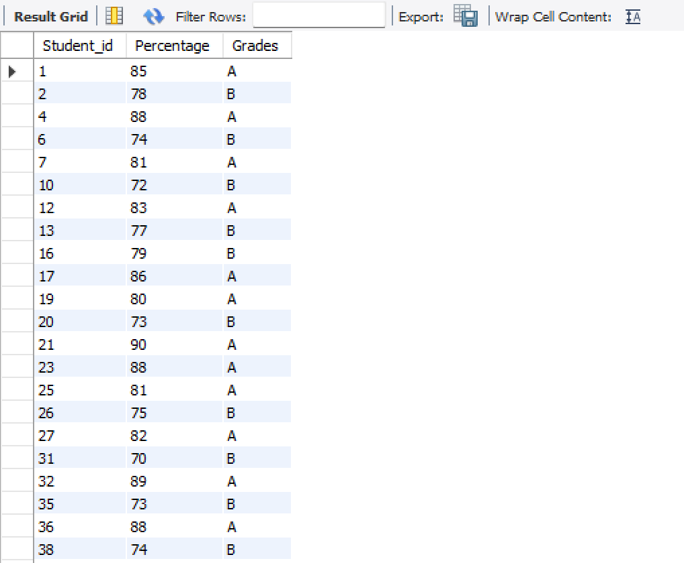
Q5. Show all students who scored between 70 and 90 Percentage
SELECT * FROM Score WHERE Percentage BETWEEN 70 AND 90;

Slide 10




SELECT * FROM Extra_Courses
WHERE Duration > 3;
Q6. Retrieve all courses that last longer than 3 months

Slide 11


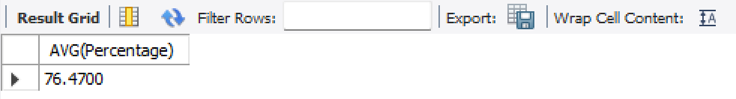
Q7. What is the average percentage of students
SELECT AVG(Percentage)
FROM Score;

Slide 12

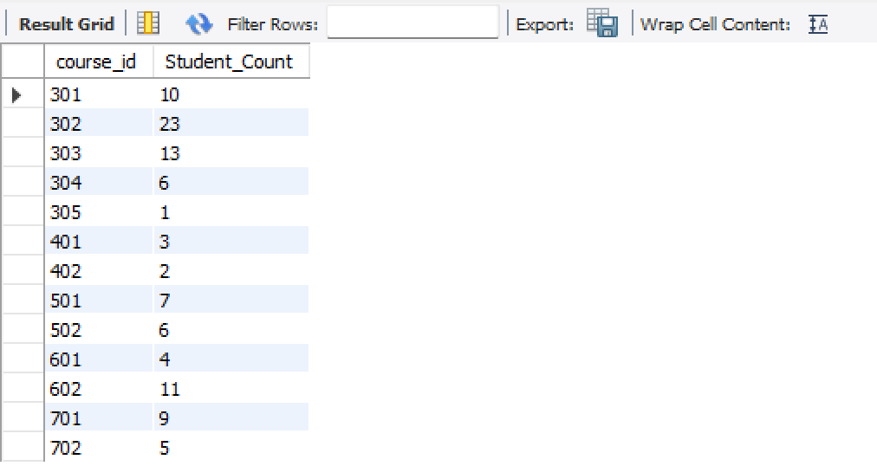

Q8. Find the total number of students enrolled in each course
SELECT course_id,
COUNT(*) AS Student_Count
FROM Students
GROUP BY course_id;

Slide 13

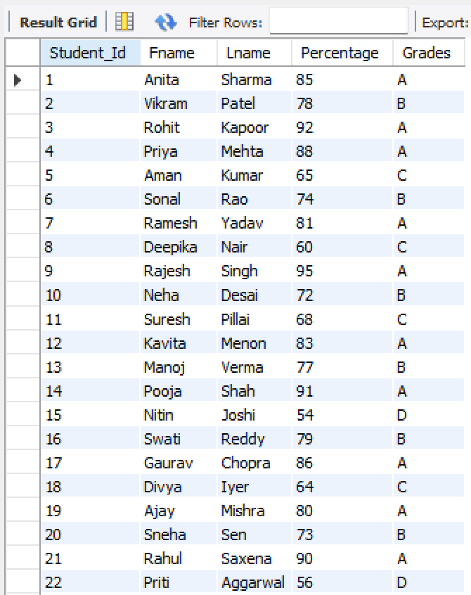

Q9. List students along with their scores and corresponding grades
SELECT distinct (S.Student_Id), S.Fname, S.Lname, SC.Percentage, SC.Grades
FROM Students as S
JOIN Score as SC
USING (student_id);

Slide 14



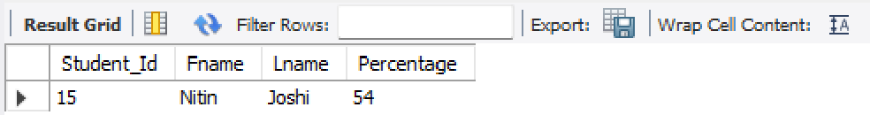
Q10. Find the student with the lowest Percentage and display their details
SELECT S.Student_Id, S.Fname, S.Lname, SC.Percentage
FROM Students as S
JOIN Score as SC ON S.Student_Id = SC.Student_id
ORDER BY SC.Percentage
LIMIT 1;

Slide 15

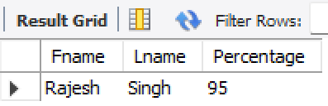

SELECT S.Fname, S.Lname, SC.Percentage
FROM Students as S
JOIN Score as SC ON S.Student_Id = SC.Student_id
ORDER BY SC.Percentage DESC
limit 1;
Q11. Student who scored the highest percentage

Slide 16
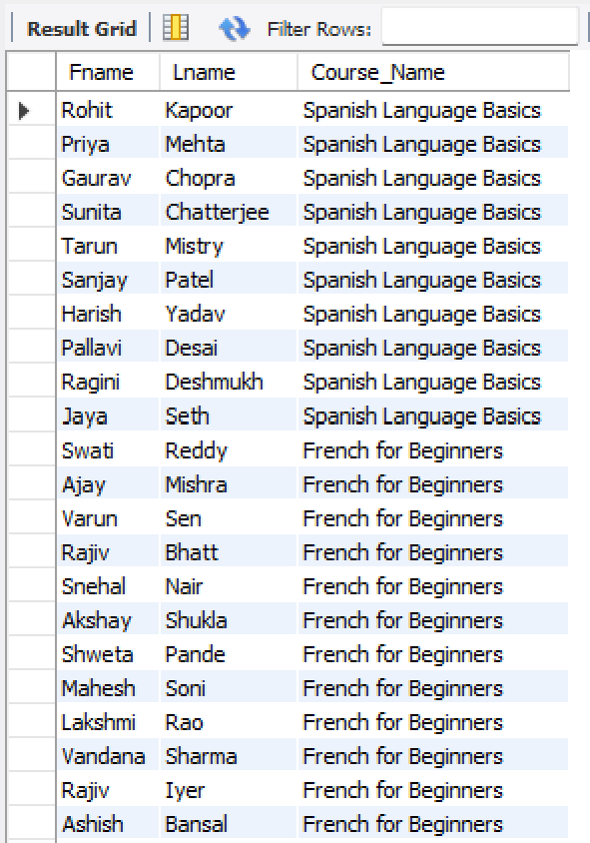

SELECT S.Fname, S.Lname, C.course_Name AS Course_Name
FROM Students as S
JOIN Extra_Courses as C ON S.Course_id = C.Course_id;
Q12. Display students and the courses they are enrolled in

Slide 17

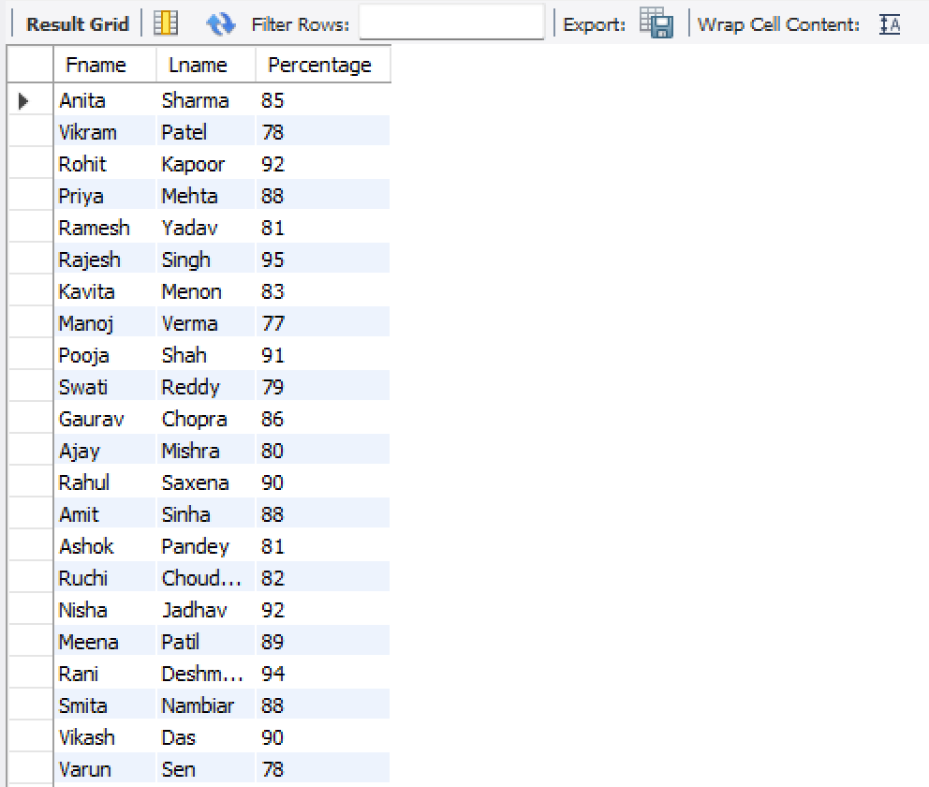
Q13. Retrieve students who scored above the average score
SELECT S.Fname, S.Lname, SC.Percentage
FROM Students as S
JOIN Score as SC
USING (student_id)
WHERE SC.Percentage > (SELECT AVG(Percentage) FROM Score WHERE course_id = S.course_id);

Slide 18

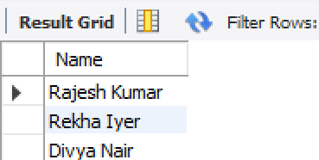
SELECT Name
FROM Faculty
GROUP BY Name
HAVING COUNT(subject) > 1;
Q14. Find faculty members teaching more than one subject

Slide 19

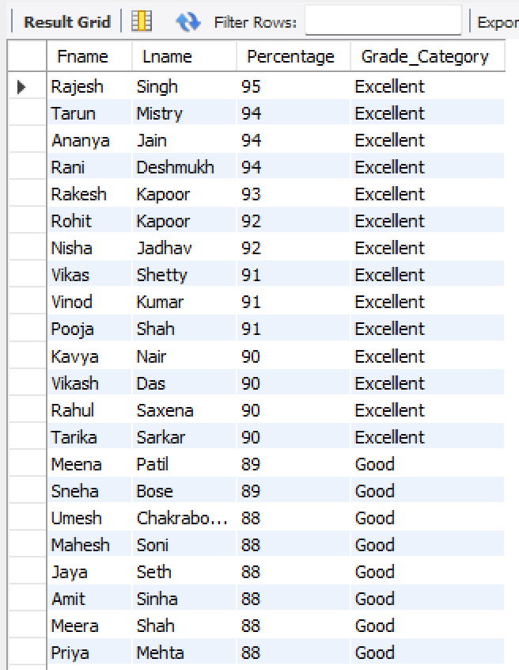
Q15. Create a list showing student names and categorize their grades as ‘Excellent’ if percentage >= 90, ‘Good’ if percentage >= 75, or ‘Needs Improvement’ if percentage < 75
SELECT S.Fname, S.Lname, SC.Percentage,
CASE
WHEN SC.Percentage >= 90 THEN 'Excellent'
WHEN SC.Percentage >= 75 THEN 'Good'
ELSE 'Needs Improvement'
END AS Grade_Category
FROM Students as S
JOIN Score as SC ON S.Student_Id = SC.Student_id
ORDER BY Percentage desc;

Slide 20

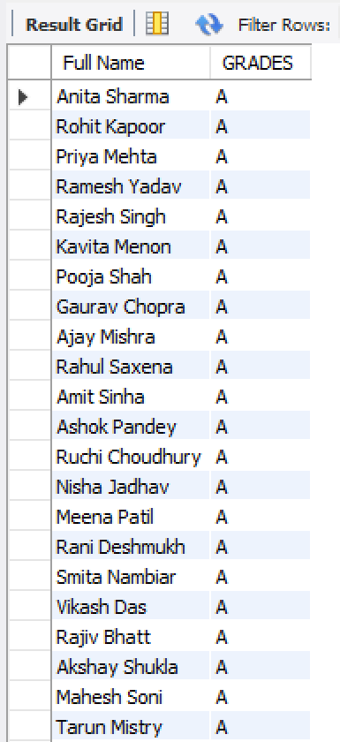


Q16. Create a Virtual Table for all the students who have "A" Grade
CREATE VIEW A_GRADE_STUDENTS AS
SELECT CONCAT(S.FNAME," ", S.LNAME) AS "Full Name", SC.GRADES
FROM STUDENTS as S
JOIN SCORE as SC USING(STUDENT_ID)
WHERE SC.GRADES="A"
ORDER BY CONCAT(S.FNAME," ", S.LNAME);
SELECT*FROM A_GRADE_STUDENTS;

Slide 21

THANK YOU !

